Slide 1
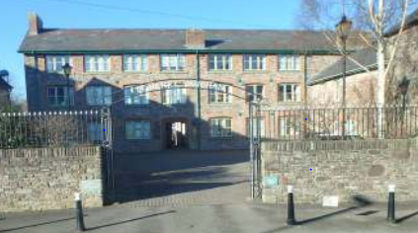
February 2025 – Activity Data
Brecon Medical Group Practice
14954
Calls into the practice
1671
Digital requests from patients
232
Medical Certificates
Issued
1591
Text messages sent
31505
Items issued via prescription
1159
Patient Referrals
159
DNA Appointments
7263
Clinical Contacts
Please visit our Practice website for more help and support with healthcare needs: www.breconmedicalgroup.co.uk

